Slide 1
Virtual Payment Platform
Issuing & Managing Virtual Cards

Slide 2
Introduction to the Platform
The Virtual Payment Platform enables users to create and manage virtual cards for online payments.
It integrates with third-party APIs for virtual card and wallet services.
Designed to support secure, fast, and scalable transactions.
Uses Redis for caching and PostgreSQL for main data storage.

Slide 3
Main System Modules
Authentication & User Management: Handles user registration, login, and token verification.
Virtual Cards API: Integrates with a third-party service to issue and manage virtual cards.
Walleting System: Connects to wallet provider APIs for deposits and withdrawals.
Transaction System: Uses Redis for fast, real-time transaction handling.
API Gateway & Edge Services: Routes requests, applies rate limits, and verifies authentication.

Slide 4
Client–Server Architecture: Request–Response Cycle
The client (mobile/web app) sends requests through the API Gateway.
The server processes the request via microservices.
The database and Redis store and return required data.
Responses are sent back securely using HTTPS.

Slide 5
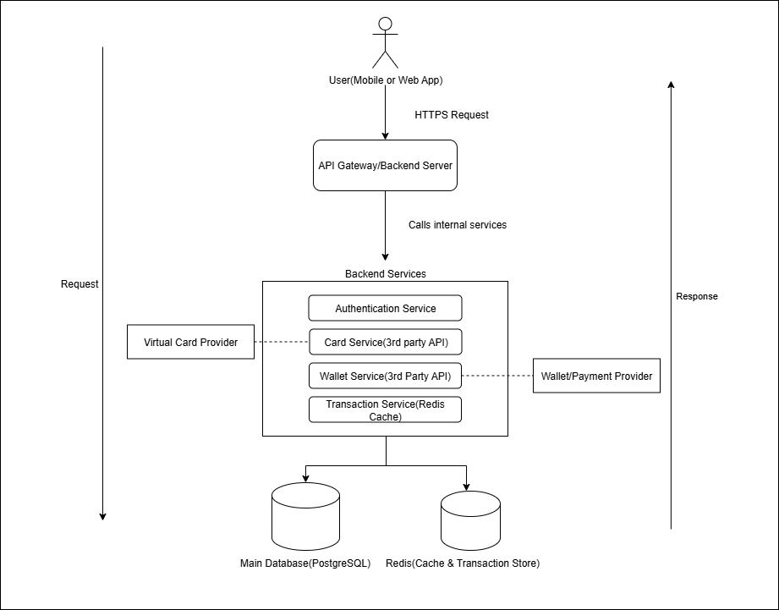
Figure 1: Client/Server Architecture Model
user → API Gateway → microservices → DB → back to user

Slide 6
Redis Function in Data Caching
Redis is used to store frequently accessed data (e.g., transactions, user sessions).
Reduces load on the main database.
Improves system speed and response time.

Slide 7
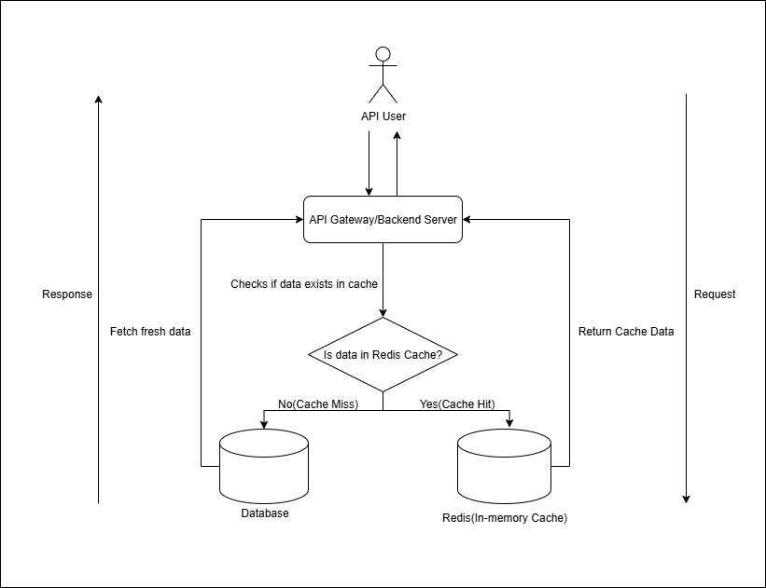
Figure 2: Redis Caching Architecture Diagram
Data flows: API checks Redis first → if found (cache hit) → returns data → else fetches from database (cache miss).

Slide 8
Overall System Architecture
The system uses microservices architecture divided into:
Edge Services: Authentication, Rate Limiter, API Gateway
Microservices Layer: Card, Wallet, Transaction, Notification Services
Data Layer: Redis (cache) + PostgreSQL (database)
Third-party Services: Virtual Card API, Wallet Provider API

Slide 9
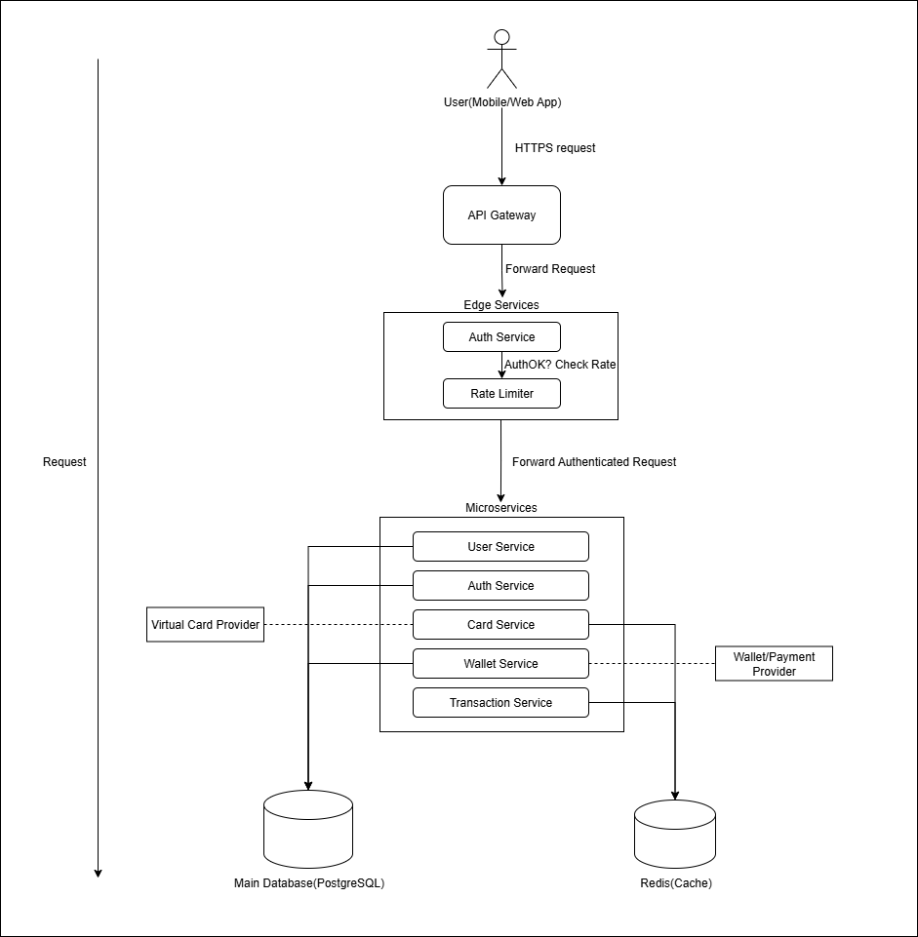
Figure 3: Overall System Architecture of the Platform

Slide 10
Edge Services
API Gateway: Routes all incoming client requests to the right service.
Authentication Service: Verifies user identity and issues access tokens.
Rate Limiter: Controls how many requests users can make per second to avoid overload.

Slide 11
Microservices Layer
Each microservice performs a specific function:
Card Service: Handles requests to issue or manage virtual cards.
Wallet Service: Connects to external wallet API for deposits/withdrawals.
Transaction Service: Uses Redis for fast transaction recording and caching.

Slide 12
Programming Languages & Databases Used
Backend Language: Node.js (JavaScript/TypeScript) — fast, scalable, good for APIs.
Frontend Framework: React Native — one codebase for mobile and web.
Database: PostgreSQL — relational, ACID-compliant, secure.
Cache System: Redis — in-memory for speed.

